Slide 1
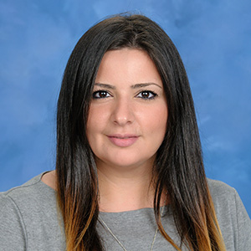
Greek Assignment frequency for virtual learners
When virtual meetings are happening, how many assignments are required per week and when they are due.
Kiria Chryssanthi Tsiaras, Greek teacher

Slide 2
Kindergarten
--- Virtual meeting is required to be attended every Monday only.
--- 1 assignment will be assigned per week.
--- That 1 assignment will be assigned on Monday of that week.
--- That 1 assignment will due Friday of that week.

Slide 3
1st Grade
--- Virtual meeting is required to be attended every Monday only.
--- 1 assignment will be assigned per week.
--- That 1 assignment will be assigned on Monday of that week.
--- That 1 assignment will due Friday of that week.

Slide 4
2nd Grade
--- Virtual meeting is required to be attended every Monday only.
--- 2 assignments will be assigned per week.
--- The 1st assignment will be assigned on Monday of that week.
--- The 2nd assignment will be assigned on Tuesday of that week.
--- Both assignments are due Friday of that week.

Slide 5
3rd Grade
--- Virtual meeting is required to be attended every Monday only.
--- 2 assignments will be assigned per week.
--- The 1st assignment will be assigned on Monday of that week.
--- The 2nd assignment will be assigned on Tuesday of that week.
--- Both assignments are due Friday of that week.

Slide 6
4th Grade
--- Virtual meeting is required to be attended every Monday only.
--- 3 assignments will be assigned per week.
--- The 1st assignment will be assigned on Monday of that week.
--- The 2nd assignment will be assigned on Tuesday of that week.
--- The 3rd assignment will be assigned on Wednesday of that week.
--- All assignments are due Friday of that week.

Slide 7
5th Grade
--- Virtual meeting is required to be attended every Monday only.
--- 3 assignments will be assigned per week.
--- The 1st assignment will be assigned on Monday of that week.
--- The 2nd assignment will be assigned on Tuesday of that week.
--- The 3rd assignment will be assigned on Wednesday of that week.
--- All assignments are due Friday of that week.

